Slide 1


Standards & Regulations Presentation
Autonomous Quadruped Assistive Search
Team B: Andrew Wong, Siddharth Saha, Connie Liu, Zack Li
November 05, 2023
Notes:
Good morning guys, we are Team B. we are here to present you the System Development review for our project: the autonomous quadruped robot for search and rescue.

Slide 2
Preview
IEEE 12207-2008: Systems and software engineering & Software life cycle processes
IEEE 1873-2015: IEEE Standard for Robot Map Data & Representation for Navigation
Notes:
In our presentation, we are going to cover the following content: use case, system-level requirements, functional architecture and cyberphysical architecture. We will elaborate the subsystems and the current system status. Last, we will discuss our project management.

Slide 3

The DarkBot Team
Notes:
My name is connie, this is andrew, zack, and saha.

Slide 4
IEEE 12207-2008:
Systems and software engineering
Software life cycle processes

Slide 5
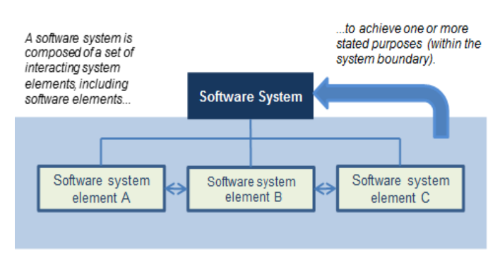
About the Standard
Processes, activities and tasks that should be applied to the software lifecycle, communication interface for any product that uses software
Intended for two-party situation - transfer of software services/products
Scope: Does not detail specific methods, processes or models for software management
Source: Standards Document
Notes:
During search and rescue, it’s risky for first responders to directly enter the site. Our project, is about a robot that collects environment information, locate stranded humans, and send it back to human operators.
To satisfy these needs, our team decides to utilize the mobility advantage of quadruped robots,
by developing features like 3D SLAM, autonomous exploration, and human detections.

Slide 6
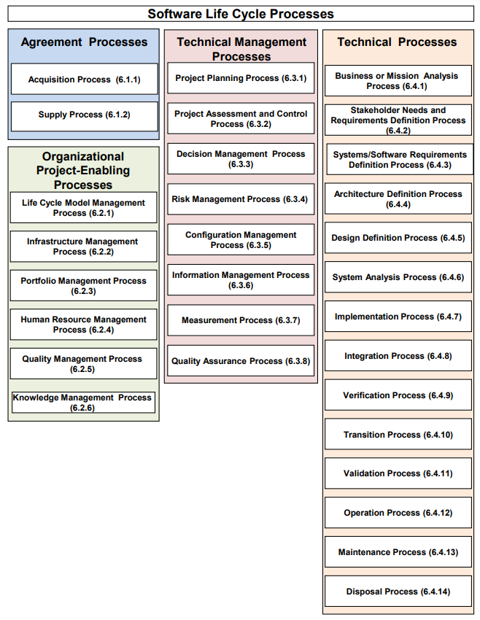
Source: Standards Document

Slide 7
Main prescriptions of the standard
We will focus on Acquisition
Need and requirements defined
Strategy for developing vs. purchasing software products
Off-the-shelf software - documentation, meets requirements, contract is agreed upon
Source: Standards Document
Notes:
During search and rescue, it’s risky for first responders to directly enter the site. Our project, is about a robot that collects environment information, locate stranded humans, and send it back to human operators.
To satisfy these needs, our team decides to utilize the mobility advantage of quadruped robots,
by developing features like 3D SLAM, autonomous exploration, and human detections.

Slide 8
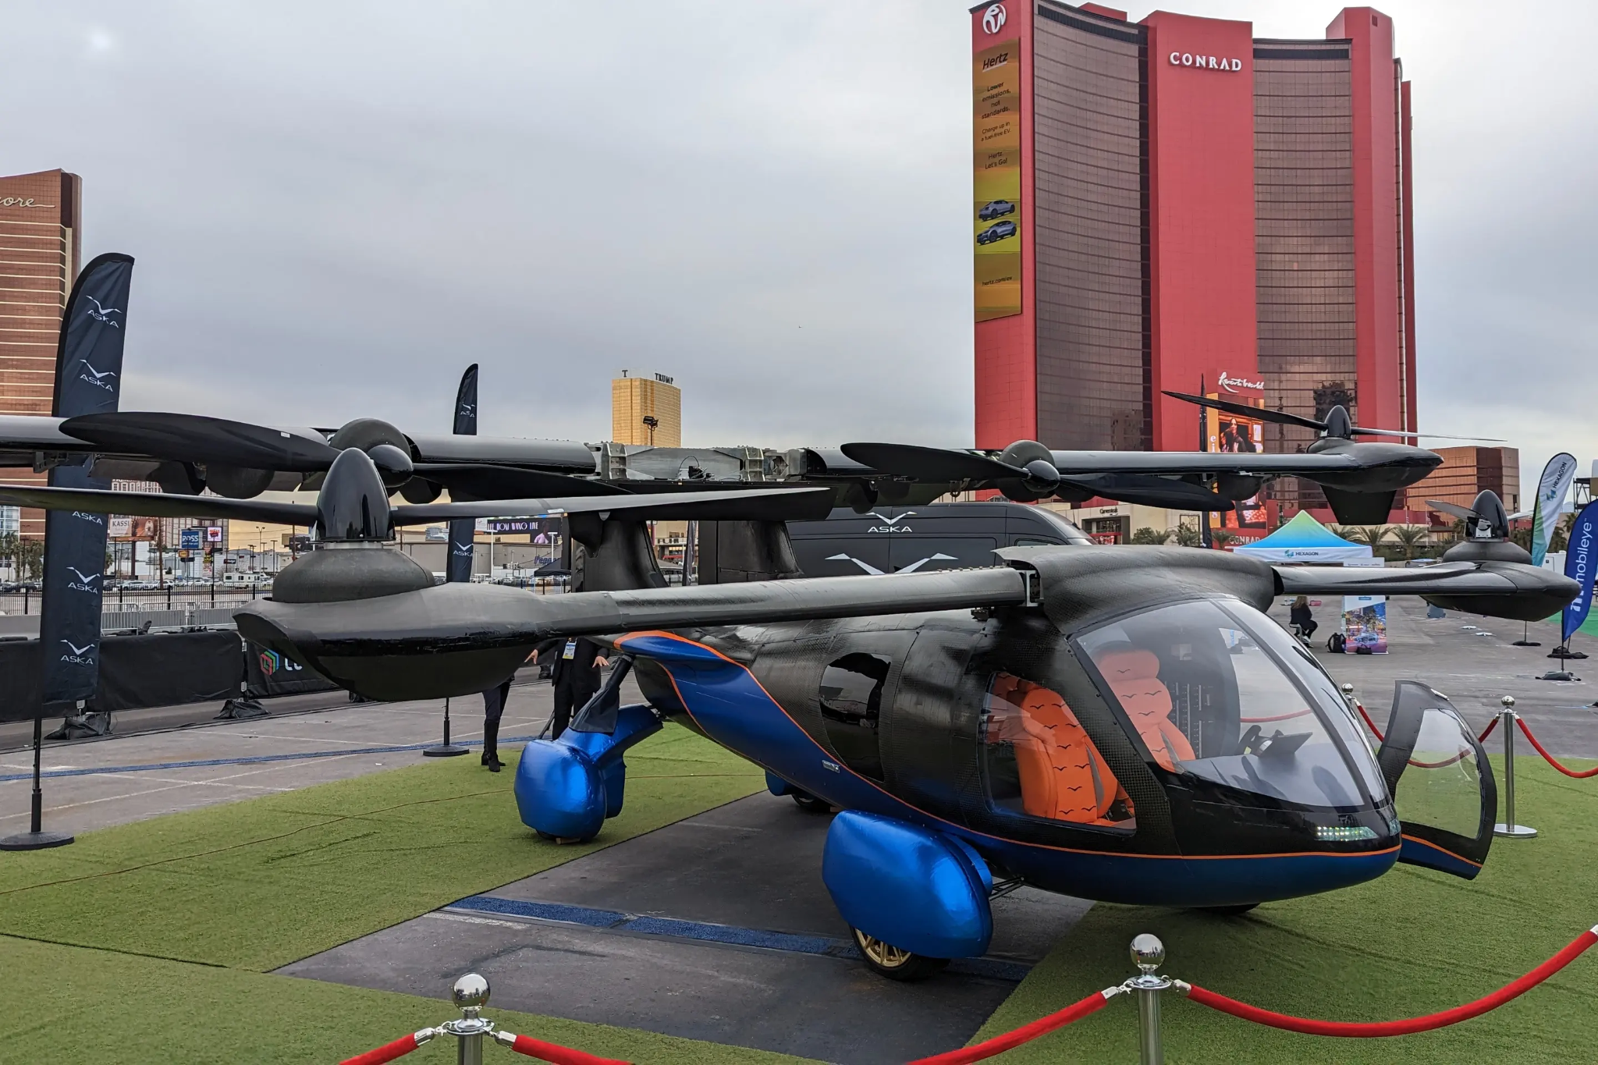
Applicable products or markets
Systems where software is acquired from an internal or external organization
Internal acquisition
Autonomous vehicle companies acquire internally developed software for their vehicles.
Flying car company ASKA build their own hardware and software for their vertically integrated battery systems
Source: ASKA website
Notes:
During search and rescue, it’s risky for first responders to directly enter the site. Our project, is about a robot that collects environment information, locate stranded humans, and send it back to human operators.
To satisfy these needs, our team decides to utilize the mobility advantage of quadruped robots,
by developing features like 3D SLAM, autonomous exploration, and human detections.

Slide 9
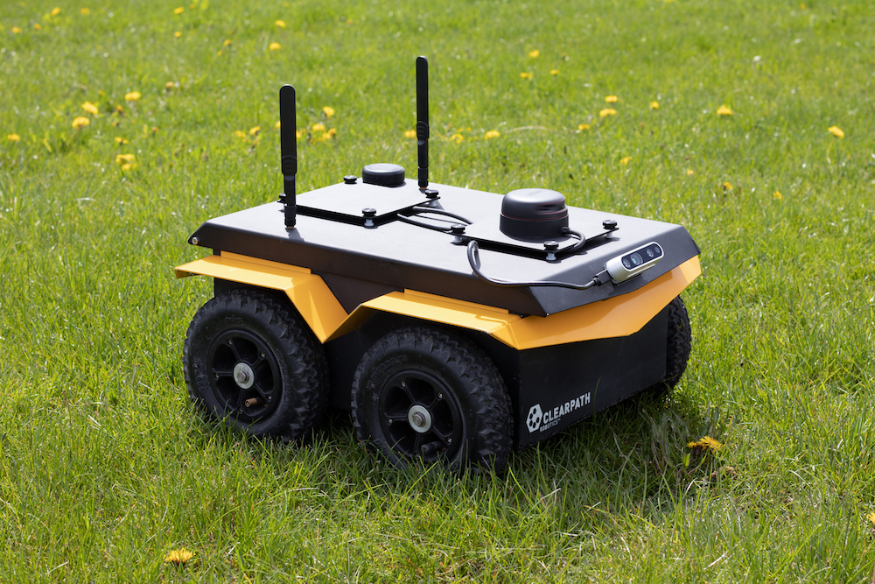
Applicable products or markets
External acquisition
Clearpath Robotics uses Robot Operating System for their communication between subsystems
Robot Operating System itself uses external middleware software like RMW
Source: Clearpath Website
Notes:
During search and rescue, it’s risky for first responders to directly enter the site. Our project, is about a robot that collects environment information, locate stranded humans, and send it back to human operators.
To satisfy these needs, our team decides to utilize the mobility advantage of quadruped robots,
by developing features like 3D SLAM, autonomous exploration, and human detections.

Slide 10
Application to the team's project
TARE Planner
Acquired exploration planning software developed by CMU Research Labs
Legged Controller
Open source software developed on ETH Zurich’s OCS2
Unitree Go1 Official SDK
Using MIT Biomedic Cheetah software
MIT License
Source: Standards Document
Notes:
During search and rescue, it’s risky for first responders to directly enter the site. Our project, is about a robot that collects environment information, locate stranded humans, and send it back to human operators.
To satisfy these needs, our team decides to utilize the mobility advantage of quadruped robots,
by developing features like 3D SLAM, autonomous exploration, and human detections.

Slide 11
IEEE 1873-2015:
IEEE Standard for Robot Map Data
Representation for Navigation

Slide 12
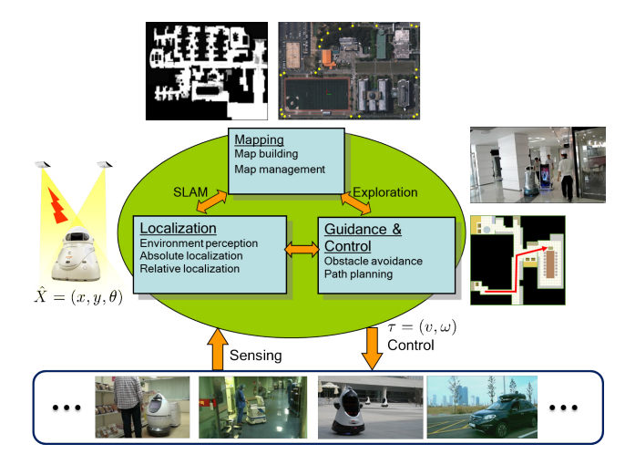
About the Standard
Goal: To provide compatible map representations for different types of robots that require navigation
Specifies common format for 2-D static topological and metric maps
Scope: does not specify how to build/maintain maps
Source: Standards Document
Notes:
During search and rescue, it’s risky for first responders to directly enter the site. Our project, is about a robot that collects environment information, locate stranded humans, and send it back to human operators.
To satisfy these needs, our team decides to utilize the mobility advantage of quadruped robots,
by developing features like 3D SLAM, autonomous exploration, and human detections.

Slide 13
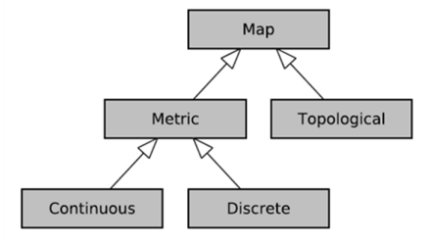
Main prescriptions of the standard
Defines a hierarchy of terminologies related to two-dimensional robot maps for navigation in indoor and outdoor environments;
Specifies a data model for each element of the hierarchy
Specifies an XML format for map data exchange between different robots, computer systems, and devices
Source: Standards Document
Notes:
During search and rescue, it’s risky for first responders to directly enter the site. Our project, is about a robot that collects environment information, locate stranded humans, and send it back to human operators.
To satisfy these needs, our team decides to utilize the mobility advantage of quadruped robots,
by developing features like 3D SLAM, autonomous exploration, and human detections.

Slide 14
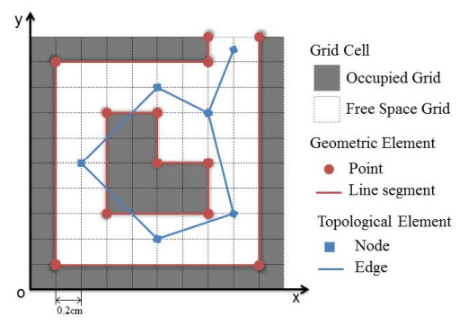
Applicable products or markets
Applicable products
Autonomous Robots
Autonomous Vehicles
Simulation Software
Navigation Modules
Applicable Industries
Manufacturing
Logistics
Healthcare
Public Infrastructure / Emergency Services
Retail
Source: Standards Document
Notes:
During search and rescue, it’s risky for first responders to directly enter the site. Our project, is about a robot that collects environment information, locate stranded humans, and send it back to human operators.
To satisfy these needs, our team decides to utilize the mobility advantage of quadruped robots,
by developing features like 3D SLAM, autonomous exploration, and human detections.

Slide 15
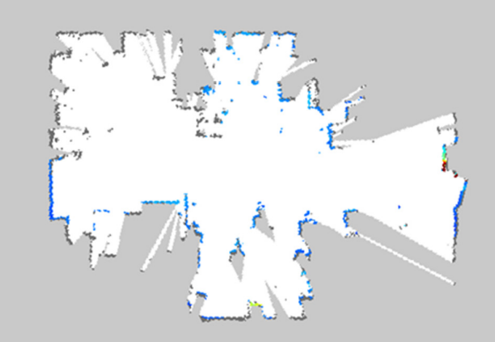
Application to the team's project
The standard is targeted at information rather than run-time use
Not ideal for run-time usage
Grid maps in ROS are following the Anybotics’ format
Source: Standards Document
Notes:
During search and rescue, it’s risky for first responders to directly enter the site. Our project, is about a robot that collects environment information, locate stranded humans, and send it back to human operators.
To satisfy these needs, our team decides to utilize the mobility advantage of quadruped robots,
by developing features like 3D SLAM, autonomous exploration, and human detections.

Slide 16
Thank you

Slide 17
Appendix

Slide 18
Grading
(1) what the standard is about; (2) what products or markets the standard is applicable to; (3) what the main prescriptions of the standard are; (4) how the standard applies to the team's project. No standard can be shared by two teams in a year. Teams will be graded on the depth of the study as presented in class, and on the presentation itself, which must be interesting, engaging, and relevant.
15 min long +- 2 min
1 min per slide

Slide 19
